Slide 1
CSCE 587 Final Review

Slide 2
Rules of Engagement
Questions can be of the form
1) Explain/show property X
2) Which properties are required for Y
3) Apply method Z
4) How do methods A and B compare
5) I have problem C what methods are applicable?
6) Multiple guess? (Probably not )

Slide 3
Support Vector Machines

Slide 4
SVMs
Type of task svm is appropriate for?
How does svm differ from other analytical approaches?
How does the svm classify in higher dimensions that are present in the input data?
What is a support vector

Slide 5
Time Series Analysis

Slide 6
Modeling a Time Series
Let's model the time series as
Y_{t} =T_{t} +S_{t} +R_{t}, t=1,...,n.
T_{t}: Trend term
Sales of iPads steadily increased over the last few years: trending upward.
S_{t}: The seasonal term (short term periodicity)
Retail sales fluctuate in a regular pattern over the course of a year.
Typically, sales increase from September through December and decline in January and February.
R_{t}: Random fluctuation
Noise, or regular high frequency patterns in fluctuation
Notes:
We present a simple model for the time series with the trend, seasonality and a random fluctuation. There is often a low frequency cyclic term as well, but we are ignoring that for simplicity.
Examples of trend and seasonality are also detailed in the slide

Slide 7
Stationary Sequences
Many time series analyses (Basic Box-Jenkins in particular) assume stationary sequences:
Mean, variance and autocorrelation structure do not change over time
In practice, this often means you must de-trend and seasonally adjust the data
ARIMA in principle can make the data (more) stationary with differencing
Notes:
A Stationary sequence is a random sequence in which the joint probability distribution does not vary over time. In other words the mean, variance and auto correlations do not change in the sequence over time.
In order to render a sequence stationary we need to remove the effects of trend and seasonality. The ARIMA model (implemented with Box Jenkins) uses the method of differencing to render the data stationary.

Slide 8
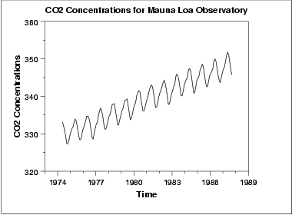
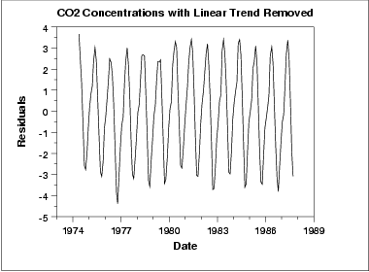
De-trending
In this example, we see a linear trend, so we fit a linear model
T*_{t} = mY_{t} + b
The de-trended series is then
Y¹_{t} = Y_{t} – T*_{t}
In some cases, may have to fit a non-linear model
Quadratic
Exponential
Notes:
Trend in a time series is a slow, gradual change in some property of the series over the whole interval under investigation.
De-trending is often applied to remove a feature thought to distort or obscure the relationships of interest.
In the example shown, the graph of CO2 concentrations measured over many years shows a linear upward trend. In climatology, for example, this CO2 trend due to urban warming might obscure a relationship between air temperature and CO2 concentration.
De-trending is a pre-processing step to prepare time series for analysis by methods that assume stationarity.
A simple linear trend can be removed by subtracting a least-squares-fit straight line. In the example shown we fit a linear model and obtain the difference. The graph shown next is a de-trended time series.
More complicated trends might require different procedures such a fitting a non-linear model such as a quadratic or a exponential model.
Use a Linear Trend Model if the first differences are more or less constant [ (y₂-y₁) = (y₃-y₂) = ……. = (y_{n}-y_{n-1}) ]
Use a Quadratic Trend Model if the second differences are more or less constant. [ (y₃-y₂) – (y₂-y₁) = ………= (y_{n}-y_{n-1})-(y_{n-1}-y_{n-2}) ]
Use an Exponential Trend Model if the percentage differences are more or constant. [ ((y₂-y₁) /y₁ ) * 100% = …….((y_{n}-y_{n-1})/y_{n-1} ) * 100%

Slide 9
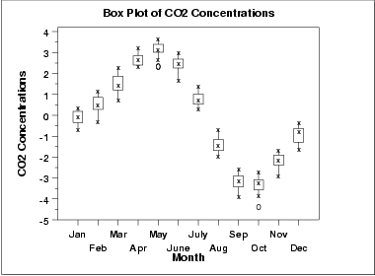
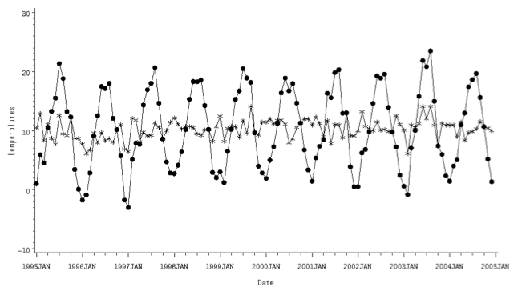
Seasonal Adjustment
Often, we know the "season"
For both retail sales and CO2 concentration, we can model the period as being a year, with variation at the month level
Simple ad-hoc adjustment: take several years of data, calculate the average value for each month, and subtract that from Y¹_{t}
Y²_{t} = Y¹_{t} – S*_{t}
Notes:
Unlike the trend and cyclical components, seasonal components, theoretically, happen with similar magnitude during the same time period each year.
The holiday sales spike is an example of seasonality. The seasonal component of a series typically makes the interpretation of a series ambiguous. By removing the seasonal component, it is easier to focus on other components.
A simple adjustment for seasonality is done with taking several years of data, calculating average value for each month and subtracting them from the actual value.

Slide 10
ARMA Model
The simplest Box-Jenkins Model
Combination of two process models
Autoregressive: Y_{t} is a linear combination of its last p values
Moving average: Y_{t} is a constant value plus the effects of a dampened white noise process over the last q time steps
Notes:
Autoregressive (AR) models can be coupled with moving average (MA) models to form a general and useful class of time series models called Autoregressive Moving Average (ARMA) models. This is the simplest Box-Jenkins model.
AR model predicts y_{t} as a linear combination of its last p values. An autoregressive model is simply a linear regression of the current value of the series on one or more prior values of the same series. Several options are available for analyzing autoregressive models, including standard linear least squares techniques. They also have a straightforward interpretation.
The time series y is called an autoregressive process of order p and is denoted as AR(p) process.
A MA model adds to y_{t} the effects of a dampened white noise process over the last q steps. This is a simple moving average or single moving average; it's probably the most basic of the forecasting methods.
What one does is to take the data from the last n periods, average the data, and use that as the forecast for the next period. We count backwards in time, minus 1, minus, 2, minus 3 and so forth until we have n data points, divide the sum of those by the number of data points, n, and that gives you the forecast for the next period. So it's called a single moving average or simple moving average. The forecast is simply a constant value that projects the next time period. “n” is also the order of the moving averages.
ARIMA – difference the Y_t d times to "induce stationarity". d is usually 1 or 2. "I" stands for integrated – the outputs of the model are summed up (or "integrated") to recover Y_t
moving average: like a random walk, or brownian motion

Slide 11
ARIMA Model
A combination of AR and MA models
The general non-seasonal model is known as ARIMA (p, d, q):
p is the number of autoregressive terms
d is the number of differences
q is the number of moving average terms
ARIMA adds a differencing term, d, to make the series more stationary
rule of thumb:
linear trend can be removed by d=1
quadratic trend by d=2, and so on…
Notes:
ARMA models can be used when the series is weakly stationary; in other words, the series has a constant variance around a constant mean.. This class of models can be extended to non-stationary series by allowing the differencing of the data series. These are called Autoregressive Integrated Moving Average(ARIMA) models. There are a large variety of ARIMA models.
ARIMA – difference the y_{t} d times to "induce stationarity". d is usually 1 or 2. "I" stands for integrated – the outputs of the model are summed up (or "integrated") to recover y_{t}
The general ARIMA (p, d, q) model gives a tremendous variety of patterns in the ACF and PACF, so it is not practical to state rules for identifying general ARIMA models. In practice, it is seldom necessary to deal with values p, d, or q that are larger than 0, 1, or 2. It is remarkable that such a small range of values for p, d, or q can cover such a large range of practical forecasting situations.

Slide 12
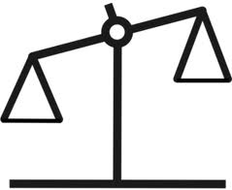
Time Series Analysis - Reasons to Choose (+) & Cautions (-)
Reasons to Choose (+) | Cautions (-)
Minimal data collection Only have to collect the series itself Do not need to input drivers | No meaningful drivers: prediction based only on past performance No explanatory value Can't do "what-if" scenarios Can't stress test
Designed to handle the inherent autocorrelation of lagged time series Compared to simple linear regression Once you've seasonally/trend adjusted | It's an "art form" to select appropriate parameters
 | Suitable for short term predictions only
Notes:
The Reasons to Choose (+) and Cautions (-) of Time Series Analysis are listed.
Time Series Analysis is not a common “tool” in a Data Scientist’s tool kit. Though the models require minimal data collection and handle the inherent auto correlations of lagged time series, it does not produce meaningful drivers for the prediction.
The selection of (p,d,q) appropriately is not very straight forward. A complete understanding of the domain knowledge and very detailed analysis of trend and seasonality may be required. Further this method is suitable for short term predictions only.

Slide 13
Hadoop

Slide 14
MapReduce: Key-Value particulars?
HDFS vs NFS?
Limitations of MapReduce?

Slide 15
K-means Clustering

Slide 16
K-Means Clustering - What is it?
Used for clustering numerical data, usually a set of measurements about objects of interest.
Input: numerical. There must be a distance metric defined over the variable space.
Euclidian distance
Output: The centers of each discovered cluster, and the assignment of each input datum to a cluster.
Centroid
Notes:
K-means clustering is used to cluster numerical data.
In K-means we define two measures of distances, between two data points(records) and the distance between two clusters. Distance can be measured (calculated) in a number of ways but four principles tend to hold true.
Distance is not negative (it is stated as an absolute value)
Distance from one record to itself is zero.
Distance from record I to record J is the same as the distance from record J to record I, again since the distance is stated as an absolute value, the starting and end points can be reversed.
Distance between two records can not be greater than the sum of the distance between each record and a third record.
Euclidean distance is the most popular method for calculating distance. Euclidian distance is a “ordinary” distance that one could measure with a ruler. In a single dimension the Euclidian distance is the absolute value of the differences between two points. The straight line distance between two points. In a plane with p₁ at (x₁, y₁) and p₂ at (x₂, y₂), it is √((x₁ - x₂)² + (y₁ - y₂)²).
In N dimensions, the Euclidean distance between two points p and q is √(∑_{i=1}^{N} (p_{i}-q_{i})²) where p_{i} (or q_{i}) is the coordinate of p (or q) in dimension i.
Though there are many other distance measures, the Euclidian distance is the most commonly used distance measure and many packages use this measure.
The Euclidian distance is influenced by the scale of the variables. Changing the scale (for example from feet to inches) can significantly influence the results.Second, the equation ignores the relationship between variables. Lastly, the clustering algorithm is sensitive to outliers. If the data has outliers and removal of them is not possible, the results of the clustering can be substantially distorted.
The centroid is the center of the discovered cluster. K-means clustering provides this as an output. When the number of clusters is fixed to k, K-means clustering gives a formal definition as an optimization problem: find the k cluster centers and assign the objects to the nearest cluster center, such that the squared distances from the cluster are minimized.

Slide 17
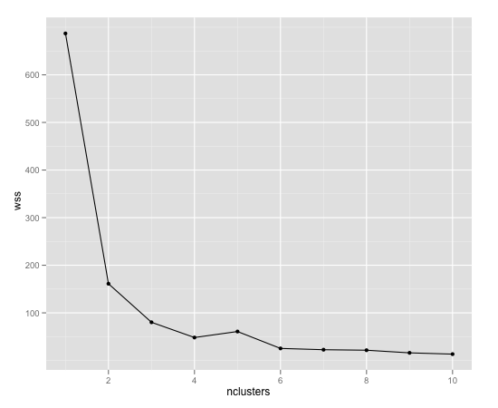
Picking K
Heuristic: find the "elbow" of the within-sum-of-squares (wss) plot as a function of K.
K: # of clusters
n_{i}: # points in i^{th} cluster
c_{i}: centroid of i^{th} cluster
x_{ij}: jth point of i^{th} cluster
"Elbows" at k=2,4,6
Notes:
Practically based on the domain knowledge, a value for K is picked and the centroids are computed. Then a different K is chosen and the model is repeated to observe if it enhanced the cohesiveness of the data points within the cluster group. However if there is no apparent structure in the data we may have to try multiple values for K. It is an exploratory process.
We present here one of the heuristic approaches used for picking the optimal “K” for the given dataset. “Within Sum of Squares” – WSS is a measure of how tight on average each cluster is. For k=1, WSS can be considered the overall dispersion of the data. WSS primarily is a measure of homogeneity. In general more clusters result in tighter clusters. But having too many clusters is over-fitting. The formula that defines WSS is shown. The graph depicts the value of WSS on the Y-axis and the number of clusters on the X-axis. The online retailer example data we reviewed earlier is the data with which the graph shown here is generated. We repeated the clustering for 12 different values .When we went from one cluster to two there is a significant drop in the value of WSS, since with two clusters you get more homogeneity. We look for the elbow of the curve which provides the optimal number of clusters for the given data.
Visualizing the data helps in confirming the optimal number of clusters. Reviewing the three pair-wise graphs we plotted for the online retailer example earlier you can see that having four groups sufficiently explained the data and from the graph above we can also see the elbow of the curve is at 4.

Slide 18
K-Means Clustering - Reasons to Choose (+) and Cautions (-)
Reasons to Choose (+) | Cautions (-)
Easy to implement | Doesn't handle categorical variables
Easy to assign new data to existing clusters Which is the nearest cluster center? | Sensitive to initialization (first guess)
Concise output Coordinates the K cluster centers | Variables should all be measured on similar or compatible scales Not scale-invariant!
 | K (the number of clusters) must be known or decided a priori Wrong guess: possibly poor results
 | Tends to produce "round" equi-sized clusters. Not always desirable
Notes:
K-means clustering is easy to implement and it produces concise output. It is easy to assign new data to the existing clusters by determining which centroid the new data point is closest to it.
However K-means works only on the numerical data and does not handle categorical variables. It is sensitive to the initial guess on the centroids. It is important that the variables must be all measured on similar or compatible scales. If you measure the living space of a house in square feet, the cost of the house in thousands of dollars (that is, 1 unit is $1000), and then you change the cost of the house to dollars (so one unit is $1), then the clusters may change. K should be decided ahead of the modeling process. Wrong guesses for K may lead to improper clustering.
K-means tends to produce rounded and equal sized clusters. If you have clusters which are elongated or crescent shaped, K-means may not be able to find these clusters appropriately. The data in this case may have to be transformed before modeling.

Slide 19
Hypothesis Testing
CSCE 587

Slide 20
Background
Assumptions:
Samples reflect an underlying distribution
If two distributions are different, the samples should reflect this.
A difference should be testable

Slide 21
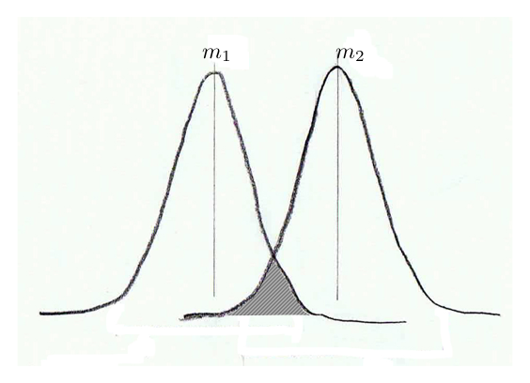
Intuition: Difference of Means
If m₁ = m₂, this area is large
Notes:
For examples 1 and 3 on the previous slide, we can think of verifying the null hypothesis as verifying whether the mean values of two different groups is the same. If they are not the same, then the alternative hypothesis is true: the introduction of new behavior did have an effect. Suppose both group1 and group2 are normally distributed, with the same variance sigma. We have n1 samples from group1 and n2 samples from group2. It happens to be true that the empirical estimate of the population means m1 and m2 are also normally distributed with variances sigma/n1 and sigma/n2 – in other words, the more samples we have, the better our estimate of the mean. If the means are really the same, then the distributions of m1 and m2 will overlap substantially.

Slide 22
Test Selection
One sample test:
compare sample to population
Actually: sample mean vs population mean
Does the sample match the population
Two sample test:
compare two samples
Sample distribution of the difference of the means

Slide 23
One Sample t-Test
Test: One Sample t-test
Used only for tests of the population mean
Null hypothesis: the means are the same
Compare the mean of the sample with the mean of the population
What do we know about the population?

Slide 24
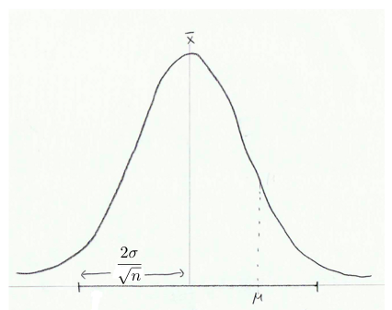
Confidence Intervals
Example:
Gaussian data N(μ, σ)
x is the estimate of μ
based on n samples
μ falls in the interval
x ± 2σ/√n
with approx. 95% probability
("95% confidence")
If x is your estimate of some unknown value μ, the P% confidence interval
is the interval around x that μ will fall in, with probability P.
Notes:
The confidence interval for an estimate x of an unknown value mu is the interval that should contain the true value mu, to a desired probability. For example, if you are estimating the mean value (mu) of a Gaussian distribution with std. dev sigma, and your estimate after n samples is X, then mu falls within +/- 2* sigma/sqrt(n) with about 95% probability.
Of course, you probably don't know sigma, but you do know the empirical standard deviation of your n samples, s. So you would estimate the 95% confidence interval as x +/- 2*s.
In practice, most people estimate the 95% confidence interval as the mean plus/minus twice the standard deviation. This is really only true if the data is normally distributed, but it is a helpful rule of thumb.

Slide 25
Association Rules
CSCE 587

Slide 26
Apriori Algorithm - What is it? Support
Earliest of the association rule algorithms
Frequent itemset: a set of items L that appears together "often enough“:
Formally: meets a minimum support criterion
Support: the % of transactions that contain L
Apriori Property: Any subset of a frequent itemset is also frequent
It has at least the support of its superset
Notes:
We will now detail the Apriori algorithm.
Apriori algorithm uses the notion of Frequent Itemset. As the name implies the frequent itemsets are a set of items “L” that appear together “often enough”. The term “often enough” is formally defined with a support criterion where the support is defined as the percentage of transactions that contain “L”.
For example:
If we define L as a itemset {shoes, purses} and we define our “support” as 50%. If 50% of the transactions have this itemset, then we say the L is a “frequent itemset”. It is apparent that if 50% of itemsets have {shoes,purses} in them, then at least 50% of the transactions will have either {shoes} or {purses} in them. This is an Apriori property which states that any subset of a frequent itemset is also frequent. Apriori property provides the basis for the Apriori algorithm that we will detail in the subsequent slides.

Slide 27
Apriori Algorithm (Continued) Confidence
Iteratively grow the frequent itemsets from size 1 to size K (or until we run out of support).
Apriori property tells us how to prune the search space
Frequent itemsets are used to find rules X->Y with a minimum confidence:
Confidence: The % of transactions that contain X, which also contain Y
Output: The set of all rules X -> Y with minimum support and confidence
Notes:
Apriori is a bottom-up approach where we start with all the frequent itemsets of size 1 (for example shoes, purses, hats etc) first and determine the support. Then we start pairing them. We find the support for say {shoes,purses} or {shoes,hats} or {purses,hats}.
Suppose we set our threshold as 50% we find those itemsets that appear in 50% of all transactions. We scan all the itemsets and "prune away" the itemsets that have less than 50% support (appear in less than 50% of the transactions), and keep the ones that have sufficient support. The word "prune" is used like it would be in gardening, where you prune away the excess branches of your bushes.
Apriori property provides the basis to prune over the transactions (search space) and to stop searching further if the support threshold criterion is not met. If the support criterion is met we grow the itemset and repeat the process until we have the specified number of items in a itemset or we run out of support.
We now use the frequent itemsets to find our rules such as X implies Y. Confidence is the percent of transactions that contain X that also contain Y. For example if we have frequent itemset {shoes,purses, hats} and consider subsets {shoes,purses}. If 80% of the transactions that have {shoes,purses} also have {hats} we define Confidence for the rule that {shoes,purses} implies {hats} as 80%.
The output of the apriori are the rules with minimum support and confidence.

Slide 28
Lift and Leverage
Notes:
The common measures used by Apriori algorithm are Support and Confidence . We rank all the rules based on the support and confidence and filter out the most “interesting” rules.
There are other measures to evaluate candidate rules and we will define two such measures Lift and Leverage.
Lift measures how many times more often X and Y occur together than expected if they were statistically independent. It is a measure of how X and Y are really related rather than coincidentally happening together.
Leverage is a similar notion but instead of a ratio it is the difference.
Leverage measures the difference in the probability of X and Y appearing together in the data set compared to what would be expected if X and Y were statistically independent.
For more measures refer to: http://michael.hahsler.net/research/association_rules/measures.html

Slide 29
Apriori - Reasons to Choose (+) and Cautions (-)
Reasons to Choose (+) | Cautions (-)
Easy to implement | Requires many database scans
Uses a clever observation to prune the search space Apriori property | Exponential time complexity
Easy to parallelize | Can mistakenly find spurious (or coincidental) relationships Addressed with Lift and Leverage measures
Notes:
While Apriori algorithm is easy to implement and parallelize, it is computationally expensive. One of the major drawbacks with the algorithm is that many spurious rules tend to get generated that are practically not very useful. These spurious rules are generated due to coincidental relationships between the variables.
Lift and Leverage measures must be used to prune out these rules.

Slide 30
Linear Regression
CSCE 587

Slide 31
Linear Regression -What is it?
Used to estimate a continuous value as a linear (additive) function of other variables
Income as a function of years of education, age, gender
House price as function of median home price in neighborhood, square footage, number of bedrooms/bathrooms
Neighborhood house sales in the past year based on unemployment, stock price etc.
Input variables can be continuous or discrete.
Output:
A set of coefficients that indicate the relative impact of each driver.
A linear expression for predicting outcome as a function of drivers.
Notes:
We use Linear regression to predict a continuous value as a linear or additive function of other variables. Some examples are
Predicting income as a function of number of years of education, age and gender (drivers).
House price (outcome) as a function of median home price in the neighborhood, square footage, number of rooms.
Neighborhood house sales in the past year based on economic indicators.
The input variables can be continuous or discrete and the outputs are:
A set of coefficients that indicate the relative impact of each driver (possibly and how strongly the variables are correlated)
A linear expression predicting the outcome as a function of drivers.

Slide 32
Technical Description
Solve for the b_{i}
Ordinary Least Squares
storage quadratic in number of variables
must invert a matrix
Categorical variables are expanded to a set of indicator variables, one for each possible value.
Notes:
Linear regressions are of the form y is equal to a constant term + a linear combination of all the variables. The linear combinations are made up of a coefficient term “b_{i}” multiplied by the value of the corresponding variable.
The problem itself is solving for the b_{i}
It is a matrix inversion problem and the method is referred to as Ordinary Least Squares (OLS). The solution requires storage as the square of the number of variables and we need to invert a matrix. The complexity of the solution (both in storage and computation) increases as the number of variables increase.
When you have categorical variables, they are expanded as a set of indicator variables one for each possible value. We will explain this in the next slide in more detail with an example.
What we highlight here is that if we expand on categorical variables (ZIP codes as a categorical value) we will end up with lot of variables and the complexity of the solution becomes extremely high.

Slide 33
Linear Regression - Reasons to Choose (+) and Cautions (-)
Reasons to Choose (+) | Cautions (-)
Concise representation (the coefficients) | Does not handle missing values well
Robust to redundant variables, correlated variables Lose some explanatory value | Assumes that each variable affects the outcome linearly and additively Variable transformations and modeling variable interactions can alleviate this A good idea to take the log of monetary amounts or any variable with a wide dynamic range
Explanatory value Relative impact of each variable on the outcome | Can't handle variables that affect the outcome in a discontinuous way Step functions
Easy to score data | Doesn't work well with discrete drivers that have a lot of distinct values For example, ZIP code
Notes:
Linear regressions have the explanatory values and we can easily determine how the variables affect the outcome. It is robust to redundant variables and correlated variables. The prediction is not impacted but we lose some explanatory value with the fitted model. Linear regression provides the concise representation of the outcome with the coefficients and it is easy to score the data with this model.
Cautions (-) are that Linear regression does not handle the missing values well. It assumes that each variable affects the outcome linearly and additively. So if we have some variables that affect the outcome non-linearly and the relationships are not actually additive the model does not fit well. Variable transformations and modeling variable interactions can address this to some extent.
It is recommended to take the log of monetary amounts or any variable with a wide dynamic range. It cannot handle variables that affect the outcome in a discontinuous way. We discussed the issue of infinite magnitude coefficients earlier where the prediction is inconsistent in ranges. Also when you have discrete drivers with a large number of distinct values the model becomes complex and computationally inefficient.

Slide 34
Logistic Regression
CSCE 587

Slide 35
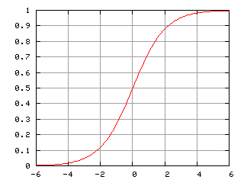
The Logistic Curve
p (probability)
z (log odds)

Slide 36
The Logistic Regression Model
predictor variables
dichotomous outcome
is the log(odds) of the outcome.

Slide 37
Relationship between Odds & Probability

Slide 38
Logistic Regression - Reasons to Choose (+) and Cautions (-)
Reasons to Choose (+) | Cautions (-)
Explanatory value: Relative impact of each variable on the outcome in a more complicated way than linear regression | Does not handle missing values well
Robust with redundant variables, correlated variables Lose some explanatory value | Assumes that each variable affects the log-odds of the outcome linearly and additively Variable transformations and modeling variable interactions can alleviate this A good idea to take the log of monetary amounts or any variable with a wide dynamic range
Concise representation with the the coefficients | Cannot handle variables that affect the outcome in a discontinuous way. Step functions
Easy to score data | Doesn't work well with discrete drivers that have a lot of distinct values For example, ZIP code
Returns good probability estimates of an event
Preserves the summary statistics of the training data "The probabilities equal the counts"
Notes:
Logistic regressions have the explanatory values and we can easily determine how the variables affect the outcome. The explanatory values are a little more complicated than linear regression. It works well with (robust) redundant variables and correlated variables. In this case the prediction is not impacted but we lose some explanatory value with the fitted model. Logistic regression provides the concise representation of the outcome with the coefficients and it is easy to score the data with this model. Logistic regression returns probability estimates of an event. It also returns calibrated model it preserves the summary statistics of the training data.
Cautions (-) are that the Logistic regression does not handle missing values well. It assumes that each variable affects the log odds of the outcome linearly and additively. So if we have some variables that affect the outcome non-linearly and the relationships are not actually additive the model does not fit well.
Variable transformations and modeling variable interactions can address this to some extent. It is recommended to take the log of monetary amounts or any variable with a wide dynamic range. It cannot handle variables that affect the outcome in a discontinuous way. We discussed the issue of infinite magnitude coefficients earlier where the prediction is inconsistent in ranges. Also when you have discrete drivers with a large number of distinct values the model becomes complex and computationally inefficient.

Slide 39
Naïve Bayes
CSCE 587

Slide 40
Bayesian Classification
Problem statement:
Given features X₁,X₂,…,X_{n}
Predict a label Y

Slide 41
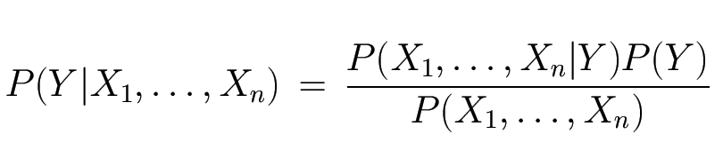
The Bayes Classifier
Use Bayes Rule!
Why did this help? Well, we think that we might be able to specify how features are “generated” by the class label
Likelihood
Prior
Normalization Constant

Slide 42
Model Parameters
The problem with explicitly modeling P(X₁,…,X_{n}|Y) is that there are usually way too many parameters:
We’ll run out of space
We’ll run out of time
And we’ll need tons of training data (which is usually not available)

Slide 43
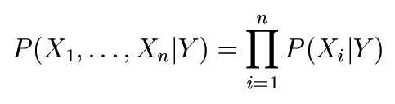
The Naïve Bayes Model
The Naïve Bayes Assumption: Assume that all features are independent given the class label Y
Equationally speaking:
(We will discuss the validity of this assumption later)

Slide 44
Why is this useful?
# of parameters for modeling P(X₁,…,X_{n}|Y):
2(2^{n}-1)
# of parameters for modeling P(X₁|Y),…,P(X_{n}|Y)
2n

Slide 45
Naïve Bayesian Classifier - Reasons to Choose (+) and Cautions (-)
Reasons to Choose (+) | Cautions (-)
Handles missing values quite well | Numeric variables have to be discrete (categorized) Intervals
Robust to irrelevant variables | Sensitive to correlated variables "Double-counting"
Easy to implement | Not good for estimating probabilities Stick to class label or yes/no
Easy to score data
Resistant to over-fitting
Computationally efficient Handles very high dimensional problems Handles categorical variables with a lot of levels
Notes:
The Reasons to Choose (+) and Cautions (-) of the Naïve Bayesian classifier are listed. Unlike Logistic regression, missing values are handled well by the Naïve Bayesian classifier. It is also very robust to irrelevant variables (irrelevant variables are distributed among all the classes and their effects are not pronounced).
The model is easy to implement and we will see how easily a basic version can be implemented in the lab without using any packages. Scoring data (predicting) is very simple and the model is resistant to over fitting. (Over fitting refers to fitting training data so well that we fit the idiosyncrasies such as the data that are not relevant in characterizing the data). It is computationally efficient and handles high dimensional problems efficiently. Unlike logistic regression Naïve Bayesian classifier handles categorical variables with a lot of levels.
The Cautions (-) are that it is sensitive to correlated variables as the algorithm double counts the effect of the correlated variables. For example people with low income tend to default and people with low credit tend to default. It is also true that people with low income tend to have low credit. If we try to score “default” with both low income and low credit as variables we will see the double counting effect in our model output and in the scoring.
Though the probabilities are provided as an output of the scored data, Naïve Bayesian classifier is not very reliable for the probability estimation and should be used for class label assignments only. Naïve Bayesian classifier in its simple form is used only with categorical variables and any continuous variables should be rendered discrete into intervals. You will learn more about this in the lab. However it is not necessary to have the continuous variables as “discrete” and several standard implementations can handle continuous variables as well.

Slide 46
Decision Trees
CSCE 587

Slide 47
Decision Tree – Example of Visual Structure
Female
Male
Gender
Female
Male
Branch – outcome of test
Income
Age
Internal Node – decision on variable
<=45,000
>45,000
<=40
>40
Yes
No
Yes
No
Leaf Node – class label
Income
Age
Notes:
Decision Trees are typically depicted in a flow-chart like manner.
Branches refer to the outcome of a decision and are represented by the connecting lines here.
When the decision is numerical, the “greater than” branch is usually shown on the right and “less than” on the left.
Depending on the nature of the variable, you may need to include an “equal to” component on one branch.
Internal Nodes are the decision or test points. Each refers to a single variable or attribute.
In the example here the outcomes are binary, although there could be more than 2 branches stemming from an internal node.
For example, if the variable was categorical and had 3 choices, you might need a branch for each choice.
The Leaf Nodes are at the end of the last branch on the tree. These represent the outcome of all the prior decisions. The leaf nodes are the class labels, or the segment in which all observations that follow the path to the leaf would be placed.

Slide 48
General Algorithm
To construct tree T from training set S
If all examples in S belong to some class in C, or S is sufficiently "pure", then make a leaf labeled C.
Otherwise:
select the “most informative” attribute A
partition S according to A’s values
recursively construct sub-trees T1, T2, ..., for the subsets of S
The details vary according to the specific algorithm – CART, ID3, C4.5 – but the general idea is the same
Notes:
We now describe the general algorithm. Our objective is to construct a tree T from a training set S. If all examples in S belongs to some class “C “ (good_credit for example) or S is sufficiently “pure” (in our case node p(credit_good) is 70% pure) we make a leaf labeled “C”.
Otherwise we will select another attribute considered as the “most informative” (savings, housing etc.) and partition S according to A’s values. Something similar to what we explained in the previous slide. We will construct sub-trees T1,T2….. or the subsets of S recursively until
You have all of the nodes as pure as required or
You cannot split further as per your specifications or
Any other stopping criteria specified.
There are several algorithms that implement Decision Trees and the methods of tree construction vary with each one of them. CART,ID3 and C4.5 are some of the popular algorithms.

Slide 49
Step 1: Pick the Most “Informative" Attribute
Entropy-based methods are one common way
H = 0 if p(c) = 0 or 1 for any class
So for binary classification, H=0 is a "pure" node
H is maximum when all classes are equally probable
For binary classification, H=1 when classes are 50/50
Notes:
The first step is to pick the most informative attribute. There are many ways to do it. We detail Entropy based methods.
Let p( c ) be the probability of a given class. H as defined by the formula shown above will have a value 0 if p (c ) is 0 or 1. So for binary classification H=0 means it is a “pure” node. H is maximum when all classes are equally probable. If the probability of classes are 50/50 then H=1 (maximum entropy).

Slide 50
Step 1: Pick the Most “Informative" Attribute Information Gain
The information that you gain, by knowing the value of an attribute
So the "most informative" attribute is the attribute with the highest InfoGain
Notes:
Information Gain is defined as the difference between the base entropy and the conditional entropy of the attribute.
So the most informative attribute is the attribute with most information gain. Remember, this is just an example. There are other information/purity measures, but InfoGain is a fairly popular one for inducing Decision Trees.

Slide 51
Decision Tree Classifier - Reasons to Choose (+) & Cautions (-)
Reasons to Choose (+) | Cautions (-)
Takes any input type (numeric, categorical) In principle, can handle categorical variables with many distinct values (ZIP code) | Decision surfaces can only be axis-aligned
Robust with redundant variables, correlated variables | Tree structure is sensitive to small changes in the training data
Naturally handles variable interaction | A "deep" tree is probably over-fit Because each split reduces the training data for subsequent splits
Handles variables that have non-linear effect on outcome | Not good for outcomes that are dependent on many variables Related to over-fit problem, above
Computationally efficient to build | Doesn't naturally handle missing values; However most implementations include a method for dealing with this
Easy to score data | In practice, decision rules can be fairly complex
Many algorithms can return a measure of variable importance
In principle, decision rules are easy to understand
Notes:
Decision Trees take both numerical and categorical variables. They can handle many distinct values such as the zip code in the data.
Unlike Naïve Bayesian the Decision Tree method is robust with redundant or correlated variables. Decision Trees handles variables that are non-linear. Linear/logistic regression computes the value as b1*x1 + b2*x2 .. And so on.
If two variables interact and say the value y depends on x1*x2, linear regression does not model this type of data correctly.
Naïve Bayes also does not do variable interactions (by design). Decision Trees handle variable interactions naturally. Every node in the tree is in some sense an interaction.
Decision Tree algorithms are computationally efficient and it is easy to score the data. The outputs are easy to understand. Many algorithms return a measure of variable importance. Basically the information gain from each variable is provided by many packages.
In terms of Cautions (-), decision surface is axis aligned and the decision regions are rectangular surfaces. However, if the decision surface is not axis aligned (say a triangular surface), the Decision Tree algorithms do not handle this type of data well.
Tree structure is sensitive to small variations in the training data. If you have a large data set and you build a Decision Tree on one subset and another Decision Tree on a different subset the resulting trees can be very different even though they are from the same data set. If you get a deep tree you are probably over fitting as each split reduces the training data for subsequent splits.
<Continued>

Slide 52
Conclusion
CSCE 587

Slide 53
Which Classifier Should I Try?
Typical Questions | Recommended Method
Do I want class probabilities, rather than just class labels? | Logistic regression Decision Tree
Do I want insight into how the variables affect the model? | Logistic regression Decision Tree
Is the problem high-dimensional? | Naïve Bayes
Do I suspect some of the inputs are correlated? | Decision Tree Logistic Regression
Do I suspect some of the inputs are irrelevant? | Decision Tree Naïve Bayes
Are there categorical variables with a large number of levels? | Naïve Bayes Decision Tree
Are there mixed variable types? | Decision Tree Logistic Regression
Is there non-linear data or discontinuities in the inputs that will affect the outputs? | Decision Tree
Notes:
This is only advisory. It's a list of things to think about when picking a classifier, based on the Reasons to Choose (+) and Cautions (-) we've discussed.

Slide 54
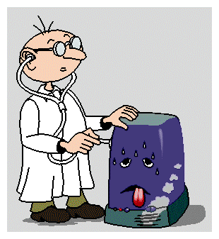
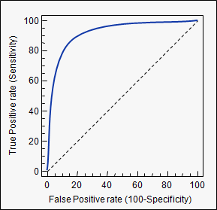
Diagnostics
Hold-out data
How well does the model classify new instances?
Cross-validation
ROC curve/AUC
Notes:
The diagnostics we used in regression can be used to validate the effectiveness of the model we built. The technique of using the hold-out data and performing N-fold cross validations and using the ROC/Area Under the Curve methods can be deployed with Naïve Bayesian classifier as well.

